Slide 1
Design Metrics
Phil Pfeiffer
April 2013

Slide 2
On "Objective" Standards for Design
Ideal: improve quality via "impartial" analyses of designs
  If you can’t measure it, you can’t manage it. -- David Garvin
  Anything that you need to quantify can be measured in some way that is superior to not measuring it at all -- Tom Gilb
Opposing view: difficulty of measuring knowledge work
  Incomplete measurements of performance can produce limited improvements in organizational performance; however,
  Knowledge work is inherently difficult to measure well
    Subjective nature of quality (see Weinberg, slide deck #1)
    Potential distortions of quality caused by working to simple metrics
    Impractical, confusing nature of complex metrics
    Source: Robert Austin, Measuring and Managing Performance in Organizations
Point of view espoused by Austin: balance
  Take measures as suggestions, not gospel

Slide 3
Strategy: Heuristic Evaluation
Checklist-based strategy for assessing design
List that follows (Barrett) addresses 7 major areas of concern:
  Abstraction
  Encapsulation
  Modularity
  Data hiding
  Completeness
  Sufficiency
  Primitiveness

Slide 4
Barrett's Checklist
Abstraction
  Each class defines one concept
  Real world concepts are modeled
  Classes ignore unimportant details
  Enough detail provided to understand, implement logic
Encapsulation
  Functions’ purposes clear
  Pre- and post-conditions correct
  Invariants correct
Modularity
  System divided into discrete subsystems
  Classes are of appropriate size
Data hiding
  Data members are private
  Functions return references
  Const, non-const used correctly
  Parameters are correct –
  by value/ reference/ address
Completeness
  Classes have all info needed to model their concepts
  Collections cover all concepts
  Sufficiency
      Classes limited to needed logic
Primitiveness
  Methods are smallest unit of operation possible

Slide 5
Cohesion and Coupling: Review
Functional: ?
Sequential: ?
Communicational: ?
Procedural: ?
Temporal: ?
Logical: ?
Coincidental: ?
Null: ?
Data: ?
Stamp: ?
Control: ?
External: ?
Common: ?
Global: ?
Content: ?

Slide 6
Cohesion and Coupling: Review
Functional: one complete job
(HIGHEST; BEST)
Sequential: subsequence of one complete job
Communicational: steps in one complete job
Procedural: subsequence across multiple, sequential jobs
Temporal: steps occurring at same time
Logical: grouping by type
Coincidental: no grouping
(LOWEST; WORST)
Null: no data exchange
(LOOSEST; BEST)
Data: pass only data needed
Stamp: entire structure but only part is used
Control: control flags or codes
External: sharing content via external elements - e.g., files
Common: via global data in named namespaces
Global: via global data outside of namespaces
Content: white-box view of private content
(TIGHTEST; WORST)

Slide 7
Qualities of Functional Complex Systems
Evolve from simple systems that work
Hierarchically structured
  Systems can be decomposed
  Usually composed of a few different kinds of subsystems (components)
  Components usually fit patterns ('stereotypes')
Choice of primitive components relatively arbitrary
  Primitive to one person is high-level to another
Intracomponent coupling generally tighter than intercomponent
  Each component developed, studied in relative isolation

Slide 8
Software Development Metrics
Span the range from estimation of effort to maturity
Selected, (largely) IEEE standard metrics:
  Bases for requirements quality estimation:
  number of conflicting requirements
  Bases for early effort estimation:
  use-case points, function points, SLOC, weighted SLOC
  Bases for in progress effort estimation:
  software maturity index
  Bases for assessing test effectiveness: test coverage
  Bases for fault assessment:
  fault density, defect density, cumulative failure profile,
  fault-days number, mean time to failure
source: Jessica Keyes, Software Engineering Productivity Handbook

Slide 9
Procedural Design Metrics
McCabe Cyclomatic Complexity (M)
Formulated in 1976 by Thos. McCabe, Sr.
Measures complexity of program's flow graph
  Compute control flow graph for program
  M = count of edges – count of nodes + 2 * number of exit nodes
NIST policy: limit complexity of individual modules to 15
Usefulness uncertain
  Tends to correlate with program size, in lines of code
  The fact that larger programs have more errors isn't particularly useful for software development
source: http://en.wikipedia.org/wiki/Cyclomatic_complexity

Slide 10
Procedural Design Metrics
Information Flow Complexity (IFC)
IFC = length * (fanin * fanout)²
length = # statements in a procedure
fanin = # local flows into a procedure + # data structures from which procedure receives data
fanout = # local flows from a procedure + # data structures that a procedure updates
Defn.: A local flow exists from procedure A → procedure B iff
A calls B, or
B calls A and A returns a value to B that is passed by B
Another module C calls A and B, passing a value from A to B

Slide 11
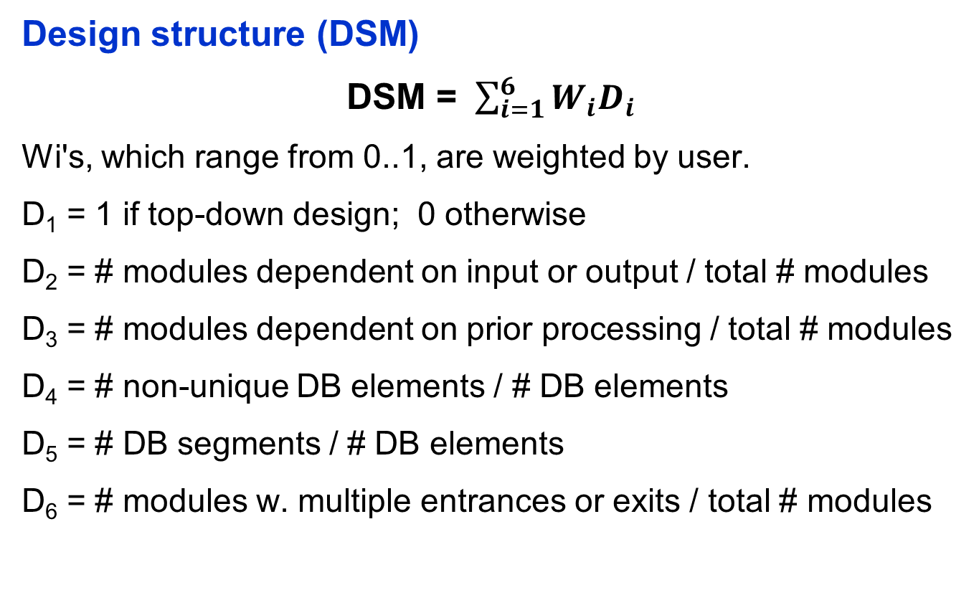
Modular Design Metrics

Slide 12
OO Design Metrics
Chidamber and Kemerer (CK) Design Suite (1994)
Weighted Methods per Class
  choose complexity measure (e.g. Cyclomatic Complexity)
  sum for each function
  want a “small” value
Depth of Inheritance Tree
  largest path from root to leaf
  balance reuse with # methods inherited into leaf nodes
Number of Children
  measures width of tree
  balance reuse, quality of parent’s abstraction
Coupling Between Object Classes
  # of collaborations (relationships)
  high coupling is bad; it limits reuse
Response for a Class
  number of methods triggered by a message
Lack of Cohesion in Methods
  # methods that access one or more common attributes
  high value indicates inter-method coupling

Slide 13
OO Design Metrics
Lorenz and Kidd (1994)
Class size: # operations, #attributes
Number Operations Overridden
Number Operations Added
Specialization Index = (NOO x level)/total # methods

